Slide 1
Nile
Team #5 Members : Rawlric Sumner, Umme Arusha, Andrew Vignali,
Priya Roy, Fazle Hameem, Minyeong Han

Slide 2
Nile - Marketplace for your brain
What is Nile - E Commerce on the blockchain
An e-commerce marketplace on blockchain using a smart contracts in solidity.
We use the 721 ERC standards for non-fungible intellectual properties ( e.g., Trademarks, Copyrights, Patents, Trade secrets)
We offer IP creators an auction platform on blockchain for better security.
Bidding and transaction data is held on decentralized computers or nodes on Ethereum network and is stored in blocks that are linked in sequence to form a chain.
Blockchain contains new and previous information blocks. The data cannot be edited or modified, so everything entered is permanent - a completely transparent system that allows all parties to see the records of that particular operation.
Notes:
M & F

Slide 3
Process
01
02
03
04
Tokenize
Auction
Mapping
Marketplace
Tokenize the IP to be auctioned
Set up auction contract and our auction contract
Map our IP registry to the Auction box
Transact
UI/UX Interface
Notes:
U

Slide 4
Why Nile?
Blockchain technology best protects sensitive content and trade secrets
Unique selling point
U
P
Easy traceability - trail of transactions provides irrefutable proof of ownership
Open source - low barrier to entry so available to everyone
T
O
Notes:
R

Slide 5
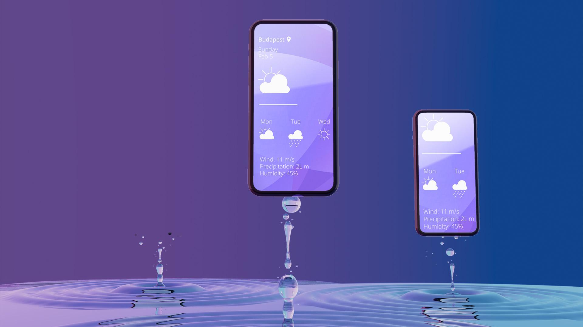
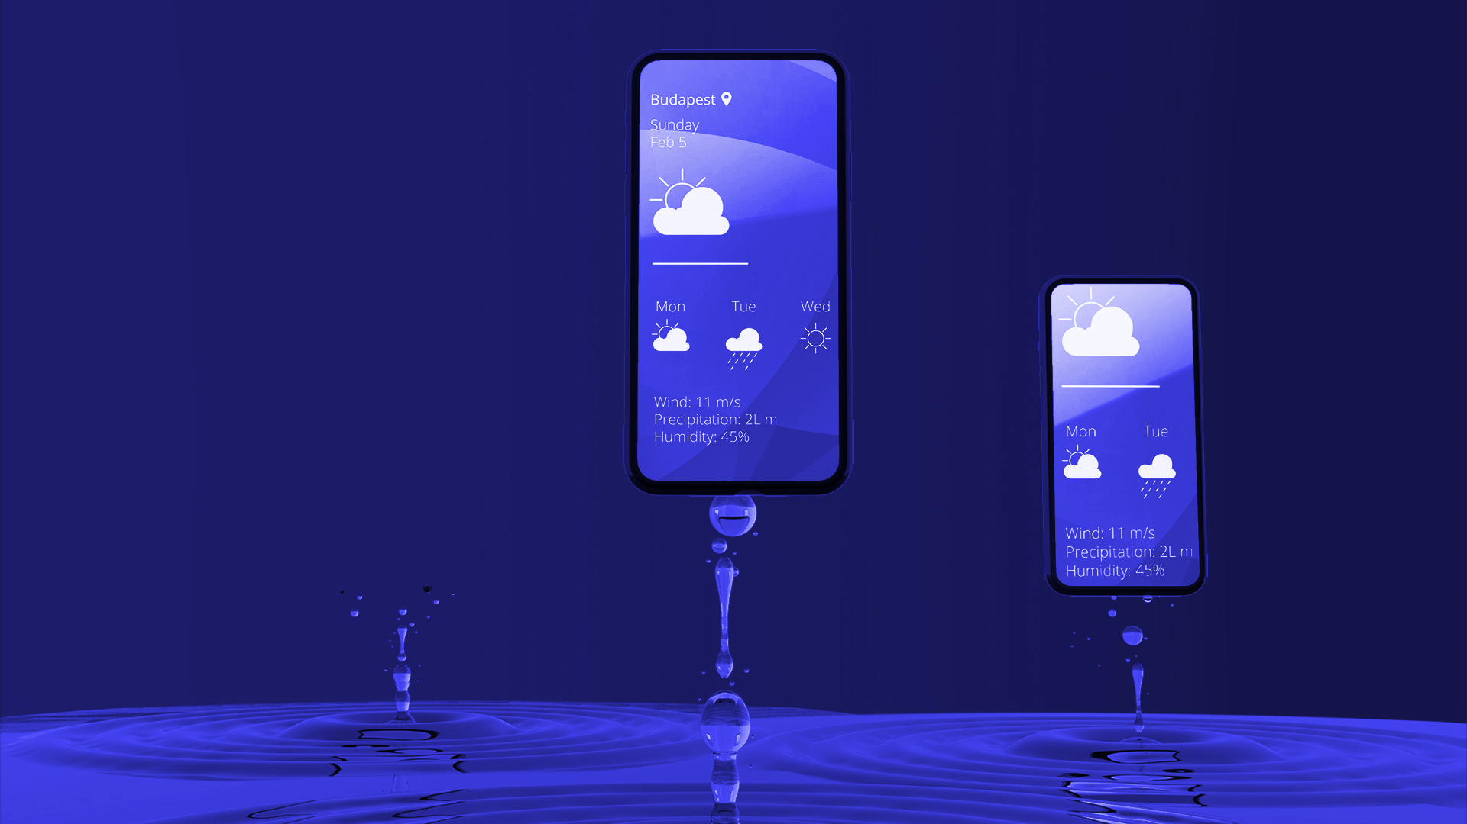
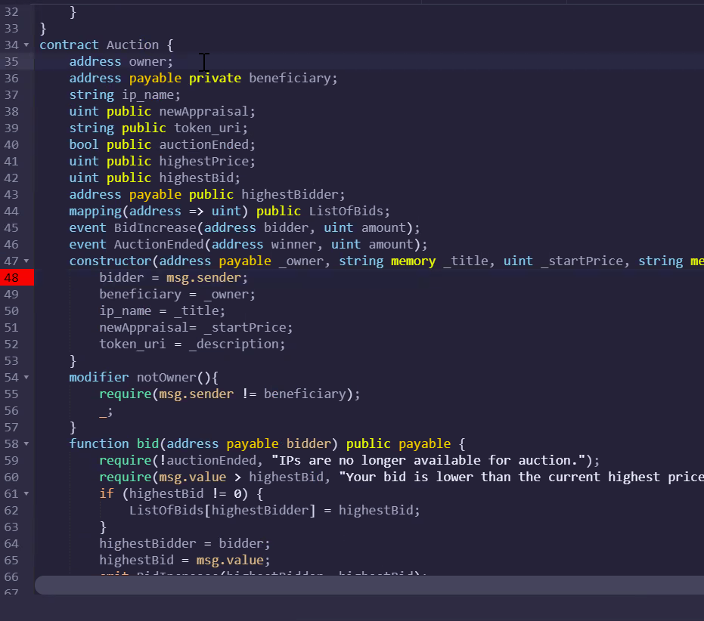
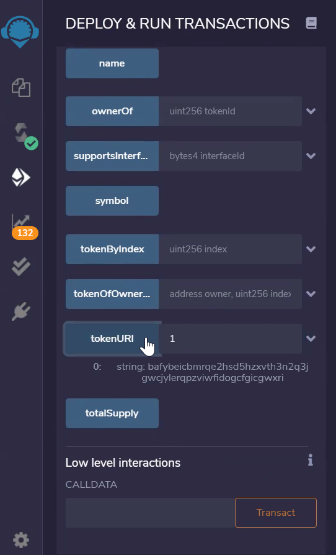
Demo
Welcome to our marketplace
Notes:
A

Slide 6
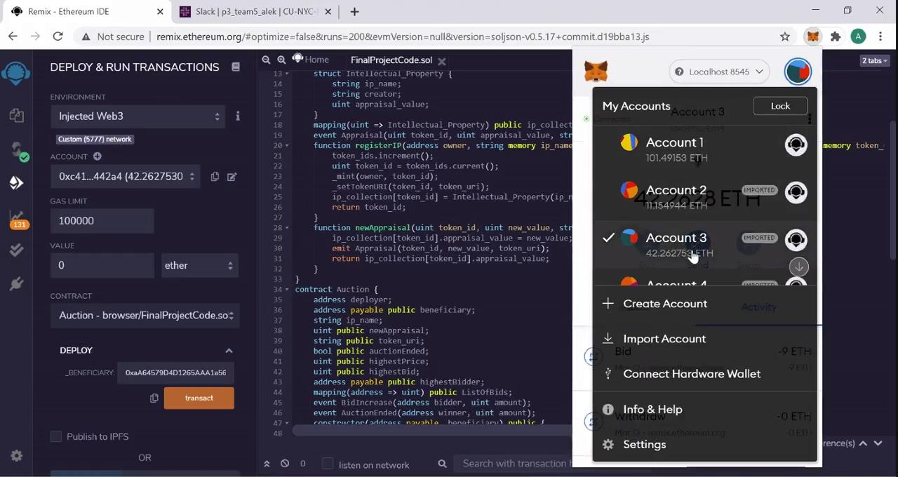
Demo

Slide 7
Our next goals - opportunities for growth
Partnerships
Multiple Transactions
Currency
Legitimize
Build the interface
Work with universities and think tanks
To support larger volumes
Moderate for currency conversions
Work with US registry
Lower the barrier to entry
Notes:
P

Slide 8

Thank You!
Do you have any questions?

Slide 10
WEATHER MAP

Slide 11
Demo
Welcome to our contracts

Slide 12
MARKET SIZE
Mars
Jupiter
Saturn
Mercury
80%
75%
60%
40%
Despite being red, Mars is actually a cold place
Jupiter is the biggest planet in the Solar System
Saturn is a gas giant and has several rings
Mercury is the smallest planet in the Solar System

Slide 13
OUR COMPANY
Mercury is the closest planet to the Sun and the smallest one in the Solar System—it’s only a bit larger than our Moon. The planet’s name has nothing to do with the liquid metal
Your logo here

Slide 14
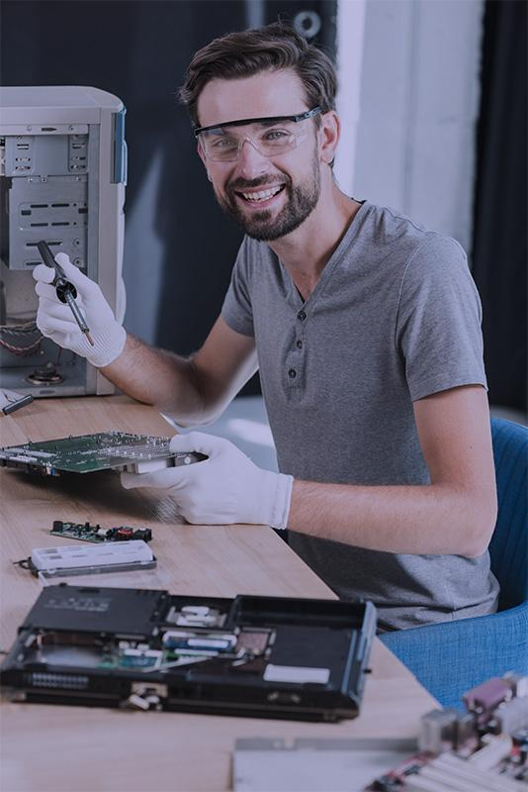



OUR TEAM
Tom James
Anna Thurman
Sarah Smith
You can replace the image on the screen with your own
You can replace the image on the screen with your own
You can replace the image on the screen with your own

Slide 15
PROBLEM
Venus has a beautiful name and is the second planet from the Sun. It’s terribly hot—even hotter than Mercury—and its atmosphere is extremely poisonous

Slide 16
THEM VS. US
Us
Them
Venus has a beautiful name and is the second planet from the Sun. It’s terribly hot
Mercury is the closest planet to the Sun and the smallest one in the Solar System

Slide 17
SOLUTION
It is the closest planet to the Sun and the smallest one in the Solar System—it’s only a bit larger than our Moon. The planet’s name has nothing to do with the liquid metal

Slide 18
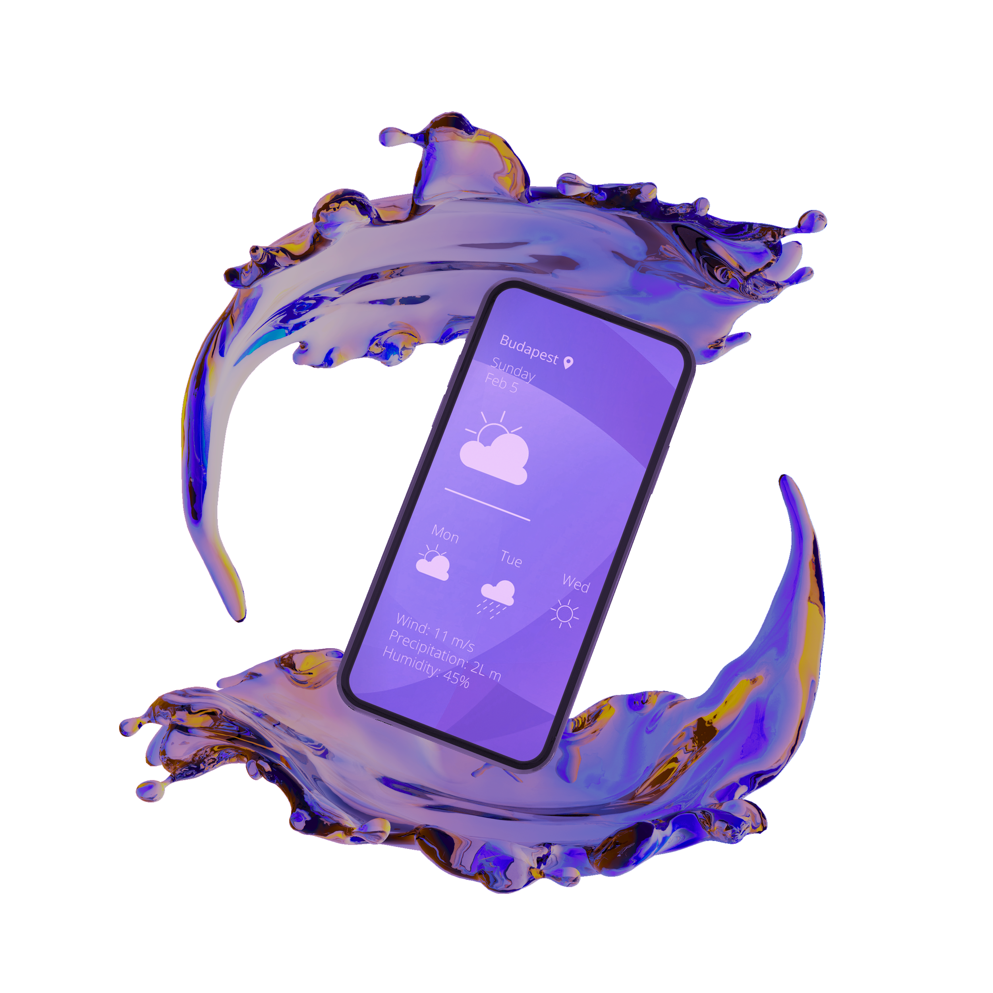
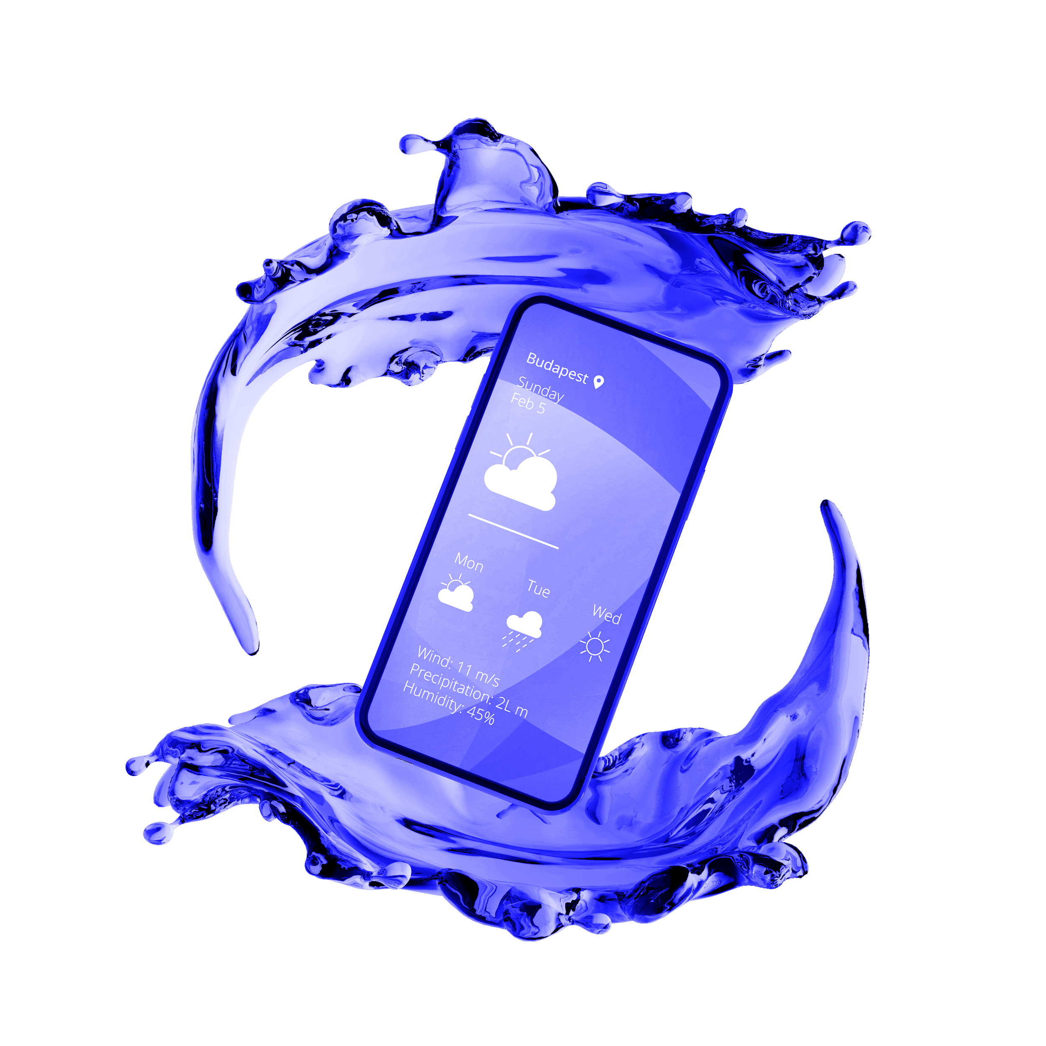
02
PRODUCT
You could enter a subtitle here if you need it

Slide 19
AWESOME WORDS

Slide 20
OUR PLANS
$0.00
$9.90
$19.90
Download now!
Download now!
Download now!
Basic
Pro
Premium
Service 1
Service 2
Service 3
Service 1
Service 2
Service 3
Service 1
Service 2
Service 3

Slide 21
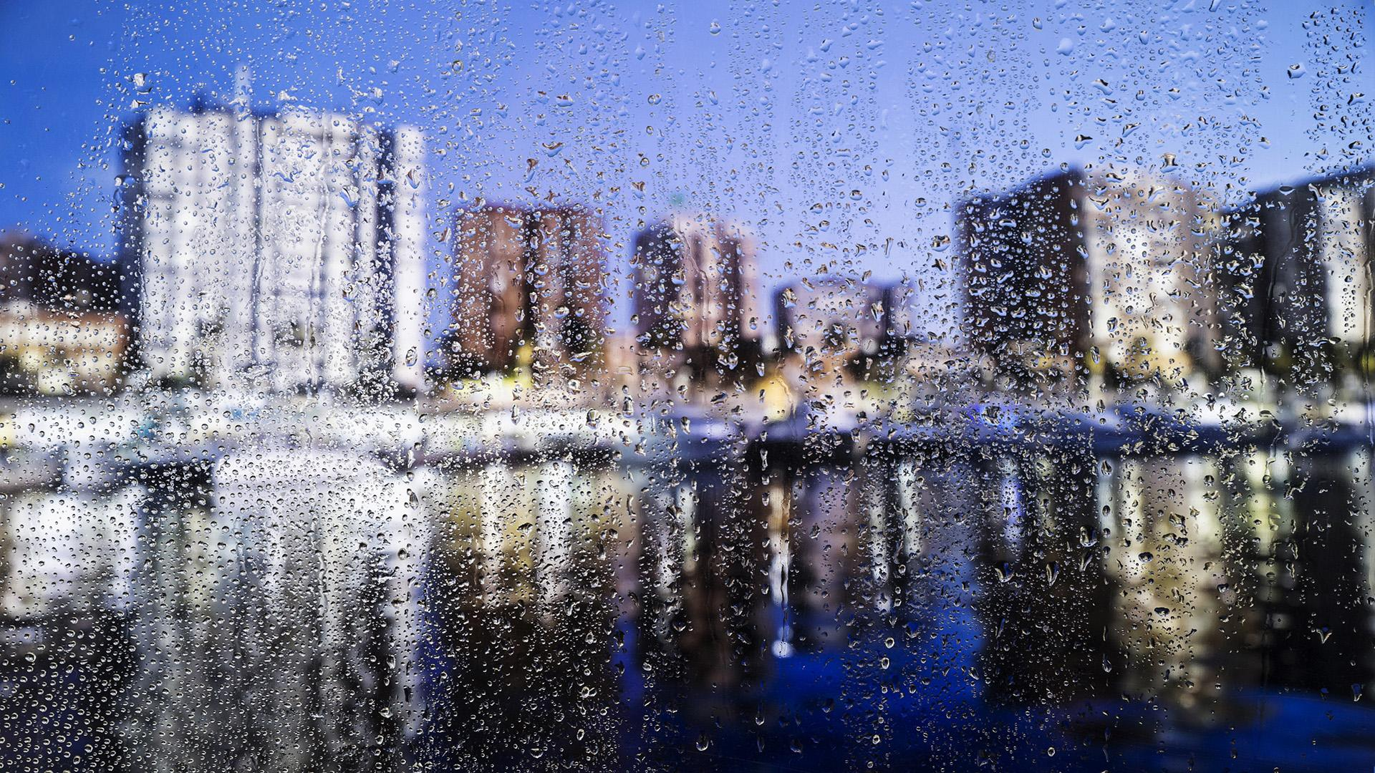
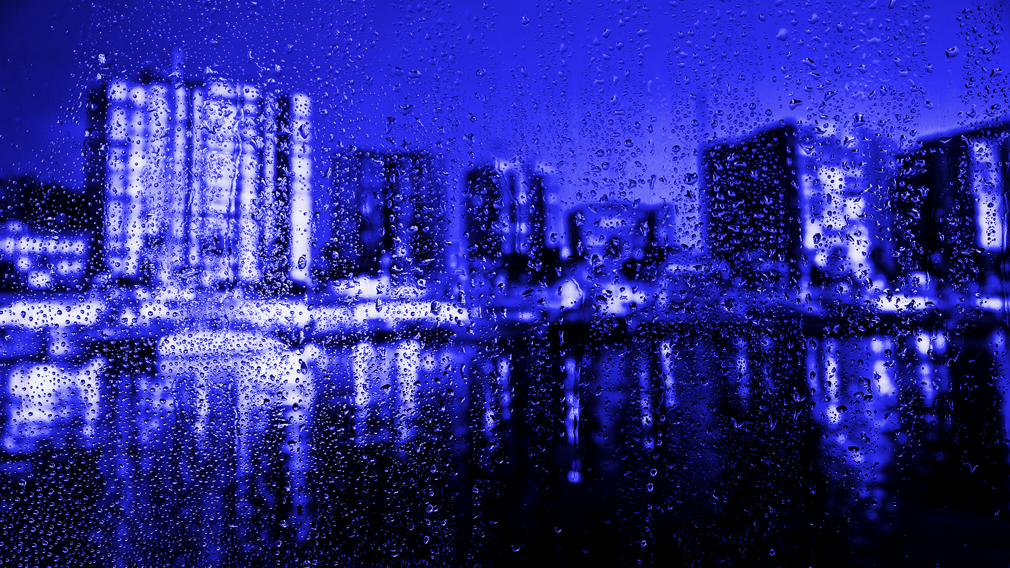
DEMO
Insert your multimedia content here
Jupiter is a gas giant and the biggest planet

Slide 22
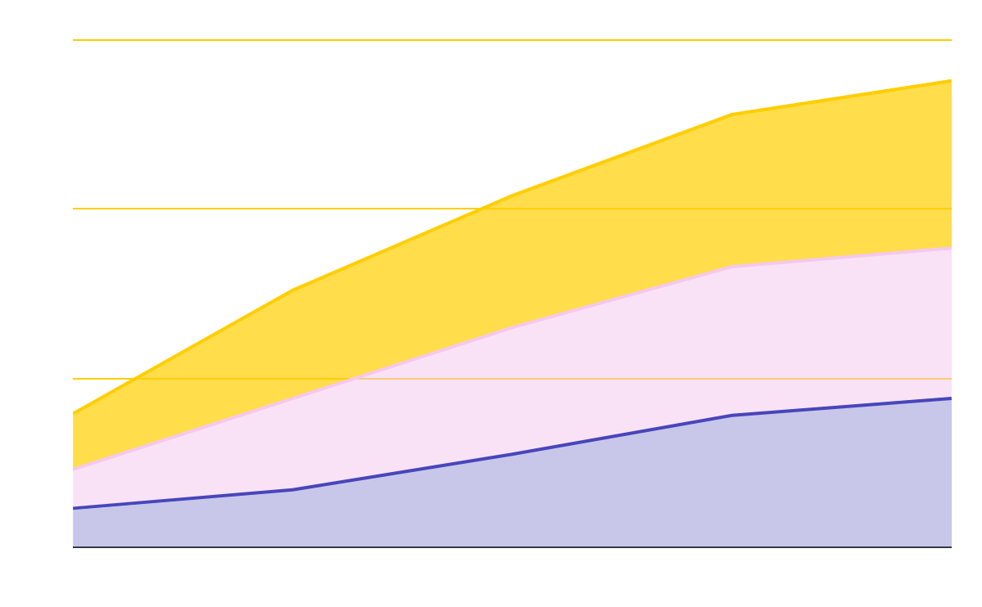
TRACTION
To modify this graph, click on it, follow the link, change the data and paste the new graph here, replacing this one
130,000
Downloads
566,000
Average Users

Slide 23
CASE STUDY
 | Challenge | Results | Solution
PROTOTYPE 1 | It is the closest planet to the Sun | Venus has a beautiful name, but it’s hot | Despite being red, Mars is a cold place
PROTOTYPE 2 | Jupiter is the biggest planet of them all | Saturn is the ringed one and a gas giant | It is the farthest planet from the Sun
PROTOTYPE 3 | Earth is the planet where we live on | Pluto is considered a dwarf planet | Ceres is in the main asteroid belt

Slide 24
TARGET
$ 50.00
40%
60%
Average spend per customer
Gender
15-25
26-35
36-45
46+
Age
Interests

Slide 25
COMPETITORS
Neptune
Venus
Mars
Saturn
Neptune is the farthest planet from the Sun
Venus has a beautiful name and it is hot
Despite being red, Mars is actually a cold place
Saturn is composed of hydrogen and helium

Slide 26
BUSINESS MODEL
Mercury
Neptune
Venus
Mars
Mercury is the closest planet to the Sun
Saturn
Neptune is the farthest planet from the Sun
Venus is the second planet from the Sun
Despite being red, Mars is a cold place

Slide 27
TIMING
Tuesday
Thursday
Monday
Wednesday
Friday
Jupiter is the biggest planet
Venus has a beautiful name
Saturn is a gas giant
Mars is a cold place
Neptune is the farthest planet

Slide 28
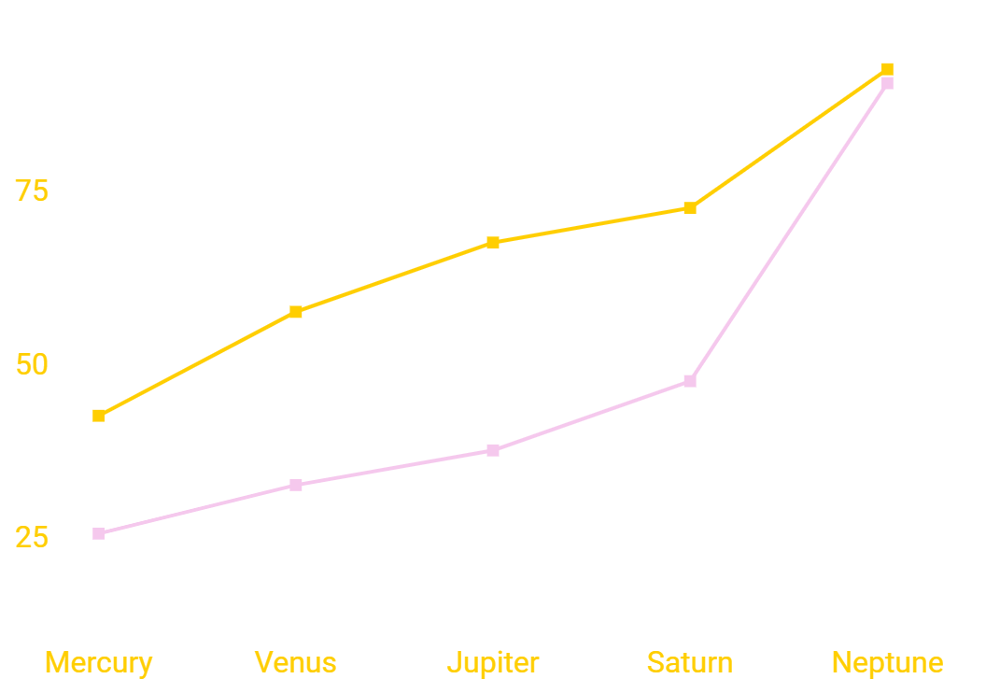
PREDICTED GROWTH
Factor 1
Factor 2
Factor 3
To modify this graph, click on it, follow the link, change the data and paste the new graph here

Slide 29
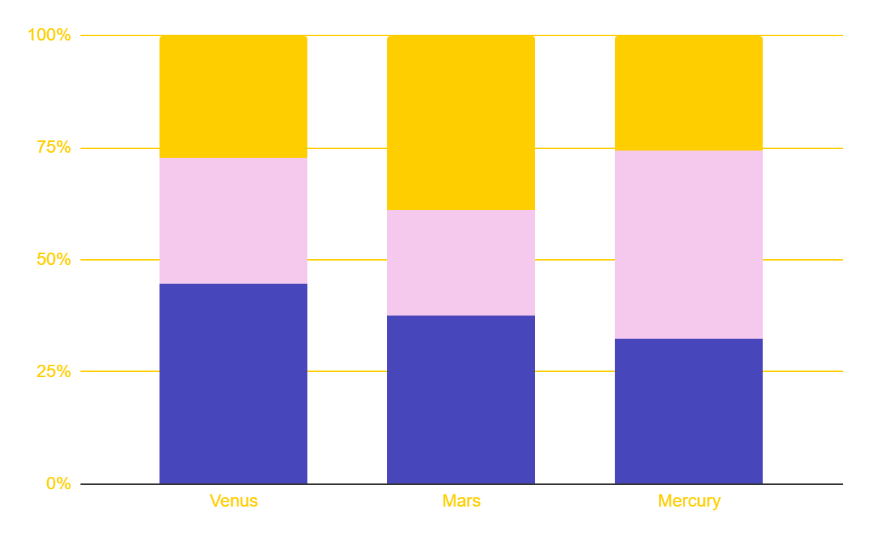
INVESTMENT
To modify this graph, click on it, follow the link, change the data and paste the new graph here
Neptune
Jupiter
Earth
It is the farthest planet from the Sun
Jupiter is the biggest planet
Earth is the planet where we live on

Slide 30
333,000,000
Saturn is a gas giant, composed mostly of hydrogen and helium

Slide 31
ALTERNATIVE RESOURCES

Slide 32
RESOURCES
Did you like the resources on this template? Get them for free at our other websites.
Mockups
3d smartphone with water effect
3d smartphone with water effect
Front view new phones
Photo
Portrait of a happy male technician working on computer motherboard
Girl with beautiful hair working on laptop
Front view of businesswoman holding notebook and pen looking at camera
Businessman and a businesswoman
Water drops on urban background
Vectors
Beautiful mountain chain landscape in the night
Colorful weather icons pack
Weather forecast icons
Weather icons
Selection of decorative clouds in flat design

Slide 33
Instructions for use
In order to use this template, you must credit Slidesgo by keeping the Thanks slide.
You are allowed to:
- Modify this template.
- Use it for both personal and commercial projects.
You are not allowed to:
- Sublicense, sell or rent any of Slidesgo Content (or a modified version of Slidesgo Content).
- Distribute Slidesgo Content unless it has been expressly authorized by Slidesgo.
- Include Slidesgo Content in an online or offline database or file.
- Offer Slidesgo templates (or modified versions of Slidesgo templates) for download.
- Acquire the copyright of Slidesgo Content.
For more information about editing slides, please read our FAQs or visit Slidesgo School:
https://slidesgo.com/faqs and https://slidesgo.com/slidesgo-school

Slide 34
Fonts & colors used
This presentation has been made using the following fonts:
Varela Round
(https://fonts.google.com/specimen/Varela+Round)
Didact Gothic
(https://fonts.google.com/specimen/Didact+Gothic)
#9393ff
#4846bb
#281b66
#ffce00
#f5c8ed
#ffffff

Slide 35




Stories by Freepik
Create your Story with our illustrated concepts. Choose the style you like the most, edit its colors, pick the background and layers you want to be visible and bring them to life with the animator panel. It will boost your presentation for sure! Check out how it works.
Pana
Amico
Bro
Rafiki

Slide 36
Use our editable graphic resources...
You can easily resize these resources without losing quality. To change the color, just ungroup the resource and click on the object you want to change. Then, click on the paint bucket and select the color you want. Group the resource again when you’re done.

Slide 39
JANUARY
FEBRUARY
MARCH
APRIL
MAY
JUNE
PHASE 1
Task 1
Task 2
PHASE 2
Task 1
Task 2
JANUARY
FEBRUARY
MARCH
APRIL
PHASE 1
Task 1
Task 2

Slide 42
...and our sets of editable icons
You can resize these icons without losing quality.
You can change the stroke and fill color; just select the icon and click on the paint bucket/pen.
In Google Slides, you can also use Flaticon’s extension, allowing you to customize and add even more icons.

Slide 43
Educational Icons
Medical Icons

Slide 44
Business Icons
Teamwork Icons

Slide 45
Help & Support Icons
Avatar Icons

Slide 46
Creative Process Icons
Performing Arts Icons

Slide 47
Nature Icons

Slide 48
SEO & Marketing Icons

Slide 49


